Slide 1
Critical Role Supervisors Play in Safety
Vanessa Pellegrino, MS

Slide 2
Today’s Focus
What are Supervisors’ Responsibilities?
You, the Supervisor, are the Organization
Setting the Example
Holding Employees Accountable

Slide 3
What are Supervisors’ Responsibilities?
Production
Quality
Inventory control
Human resources
Safety
Enforce rules
Delegate work
Organize the work
Solve routine problems
Train employees

Slide 4
What are Supervisors’ Responsibilities?
What are they responsible for specifically and solely in safety?
Perform daily inspections
Report/correct unsafe conditions
Assist in accident investigations
Train employees on hazards
Develop safe work procedures/JHA’s
Equipment is maintained
Enforce safety regulations/policies
Ensure personal protective equipment (PPE) is provided
Prevent accidents

Slide 5
What are Supervisors’ Responsibilities?
Who generally gets promoted to Supervisor?
The best worker
But are they going to make a good/great/amazing supervisor?

Slide 6
What are Supervisors’ Responsibilities?
Now we know how they’re chosen
Now we know ALL that they’re responsible for
Now we know everything they have to manage for safety
So, what?
Big deal!

Slide 7
What are Supervisors’ Responsibilities?
What’s significant in this simplified chart?
Who interfaces with the employees?
More specifically, who from the Organization, interacts with the employees?
SUPERVISOR!
Management
Supervisor
Employee 1
Employee 2
Employee 3

Slide 8
What are Supervisors’ Responsibilities?
Safety 101 we learn the supervisor is the key.
“The supervisor bears the greatest responsibility and accountability for implementing the safety and health program because it is he or she who works most directly with the employee.”
Occupational Safety and Health Management, Thomas J. Anton

Slide 9
You, the Supervisor, Are the Organization
Which leads us to the next topic listed above.
Is that accurate?
Do you believe it?
That’s ok, I’ll show you that my opinion is true.
Just stick with me.

Slide 10
You, the Supervisor, Are the Organization
The corporate office has a message to give to the employees – who delivers it?
There’s a new policy developed and everyone needs trained on it – who does it?
An employee has a problem with implementation of a work procedure – who do they discuss it with?
An employee is injured, has a machine not working properly, has a problem with a co-worker, is mad at their spouse – who do they turn to?

Slide 11
You, the Supervisor, Are the Organization
Let’s take this to another level:
Employees view you as “Management”
Courts may view you as “Employer”

Slide 12
You, the Supervisor, Are the Organization
The Organization’s dirty little secret:
Liability
Responsible for your employees leaving work without any injuries and without dying
Implement all of our directives
When there’s an employee issue YOU are the first person we’re going to turn to for answers
When there’s ANY issue on the floor/the field/the office we’re turning to YOU for an explanation first

Slide 13
You, the Supervisor, Are the Organization
My point:
YOU, THE SUPERVISOR, HAVE A TREMENDOUS AMOUNT OF RESPONSIBILITY
YOU, THE SUPERVISOR, HAVE A TREMENDOUS IMPACT ON EMPLOYEES

Slide 14
You, the Supervisor, Are the Organization
The Role of Supervisors in Behavioral Safety Observations, study in Professional Safety, October 2000, page 33.
A company trained their employees and supervisors on how to conduct observations and asked them to conduct two observations a month at many locations.
Participation was measured.

Slide 15
You, the Supervisor, Are the Organization

Slide 16
You, the Supervisor, Are the Organization
Now that you know I’m right and what’s listed above IS how it is…
It’s time for me to come clean…
I’ve been setting you up for the two most important topics today

Slide 17
Setting The Example
Given, that you ARE the organization everything you say and do will be seen by employees as the organization’s words and actions.
Holy crap…that’s heavy

Slide 18
Setting The Example
How does this apply, specifically, to safety?
Employees watch your actions to determine your attitude toward safety
Employees believe that whatever your attitude toward safety is IS that of the organization

Slide 19
Setting The Example
Employees will watch your actions to determine your attitude toward safety.
What that means for Supervisors is that you’re always on stage.
They watch how you handle different situations.

Slide 20
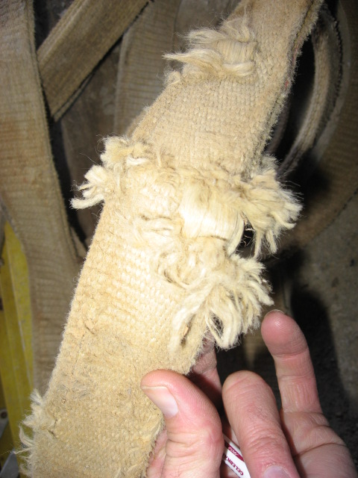
Set The Example
Unsafe act picture

Slide 21
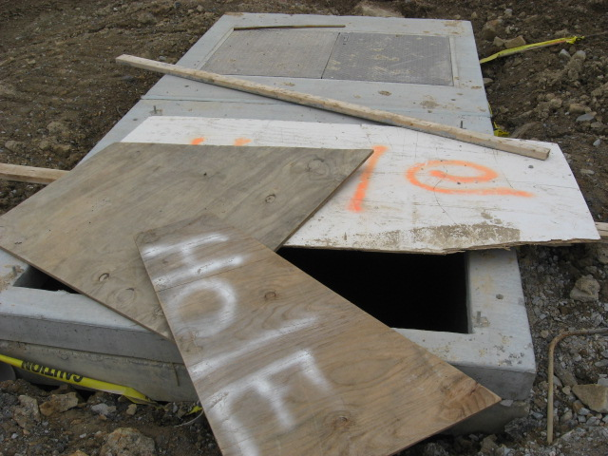
Set The Example
Unsafe act picture

Slide 22
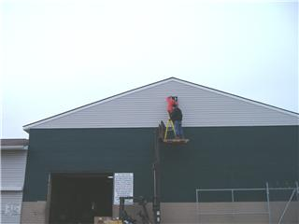
Set The Example

Slide 23
Set The Example

Slide 24
Setting The Example
If you see it and you do nothing – YOU ARE CONDONING IT
And here’s what could result

Slide 25
Setting The Example
What happens when unsafe behavior is condoned?
People are more willing to take risks
People will take short cuts because they’ll assume that’s expected
People don’t bother to wear their PPE
People will assume you don’t care about their safety
People will become resentful
People will know that the “safety program” is a sham and is all for OSHA
Safety degrades

Slide 26
Setting The Example
Since we don’t want safety to degrade what can we do?
Quite simply, address safety concerns when you see or hear or are told them.
Get the item fixed
Provide coaching to the employee
Wear all of your PPE
Ensure everyone’s following proper procedures
Stop the task/work when there’s a safety issue
Hold employees accountable (must do this yourself first)

Slide 27
Holding Employees Accountable
Worthy of discussion
Nobody likes to do it
Nobody’s trained on how to do it
It’s easier to look the other way
People are simply uncomfortable addressing issues that are deemed “bad” with other people (that’s why there’s so much bickering behind others’ backs)

Slide 28
Holding Employees Accountable
Some common issues with holding people accountable:
We don’t hold the “good producers” accountable for safety because we don’t want to impact their production (same is true for the opposite)
We only hold people accountable for safety issues when it impacts production or machinery is broke or someone is injured
We don’t hold people accountable for safety but we do hold them accountable for production issues
We only hold the employee accountable but NOT the supervisor
It only works if done consistently and fairly

Slide 29
Holding Employees Accountable
One other note:
OSHA comes onto your sight and sees an employee not wearing the appropriate PPE.
Your response to OSHA is “All employees are required to wear PPE”.
Does OSHA says “OK, that’s good enough”?
OSHA will want to see records of where the organization enforced their policy of wearing the appropriate PPE.
If you have no documentation OSHA will then know that the PPE policy is NOT REAL.

Slide 30
Holding Employees Accountable
Let’s discuss how we could be handling employee accountability
Usually employees are held accountable with some type of disciplinary system
Usually progressive
Verbal (this is documented)
Written
Days Off without Pay
Termination

Slide 31
Holding Employees Accountable
Vanessa’s advice:
Know your discipline policy
Keep an open mind when approaching someone not following policy
Use your discipline policy fairly and consistently
Use your Human Resources and Safety Managers for support/advice
DOCUMENT
DOCUMENT
DOCUMENT

Slide 32
Summary
Supervisors have a unique and challenging role within organizations
Safety is one of the many areas supervisors are charged to manage
It is critical that supervisors understand the example they are for all employees
If a supervisor does not hold their employees accountable for safety there is no safety
Support your supervisors – they have too much on their plate to do it alone

Slide 33
Summary
Management
Provide training your Supervisors
Give them the tools to do the job
Support their decisions
Hold them accountable for safety
Safety
Provide support to your Supervisors
Provide education to your Supervisors

Slide 34
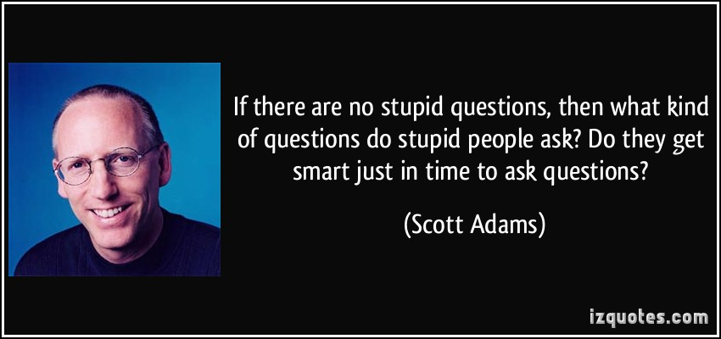
Questions

